Slide 1
SE Asia
Factors of
ECONOMIC GROWTH
© Brain Wrinkles

Slide 2
OBJECTIVE
SS7E9 Describe factors that influence economic growth and examine their presence or absence in China, India, Japan, South Korea, and North Korea.
Evaluate how literacy rates affect the standard of living.
Explain the relationship between investment in human capital (education and training) and gross domestic product (GDP per capita).
Explain the relationship between investment in capital goods (factories, machinery, and technology) and gross domestic product (GDP per capita).
Describe the role of natural resources in a country’s economy.
Describe the role of entrepreneurship.
© Brain Wrinkles

Slide 3
Gross
Domestic
Product
© Brain Wrinkles

Slide 4
GDP
Economists measure the health of a country’s economy by its gross domestic product (GDP).
A country’s GDP is the total dollar value of all goods and services produced in one year.
Some countries have a high GDP, while others do not.
© Brain Wrinkles

Slide 5
per Capita
GDP is often measured as “GDP per capita” (per person).
Countries with a higher GDP per capita have stronger economies, while countries with lower GDP per capita have weaker economies.
GDP per capita is a good indicator of a country’s standard of living.
The standard of living is the level of wealth and material comfort available to the people.
© Brain Wrinkles

Slide 6
SE Asia
For the most part, the GDP per capita in the Southern and Eastern Asian region tends to be lower than the figures found in Europe, Canada, Australia, and the United States.
However, the GDP per capita (for most countries) is higher than that of most African countries.
GDP per capita varies widely throughout the region.
© Brain Wrinkles

Slide 7
SE Asia
Country | GDP Per Capita
China | $10,261
India | $2,099
Japan | $40,246
South Korea | $31,846
North Korea | $1,300
United States | $65,297
© Brain Wrinkles

Slide 8
Productive
Resources
A nation’s productive resources determine the strength of its economy.
Productive resources are the materials and labor used to create goods and services.
The four main categories of productive resources are natural resources, human capital, capital goods, and entrepreneurship.
© Brain Wrinkles

Slide 9
Natural
Resources
© Brain Wrinkles

Slide 10
Natural
Resources
Natural resources are the materials that come from nature, such as land, forests, minerals, water, etc.
They play an important role in a country’s economy because they are fuel for industry and are a source of income when exported to other countries.
The availability of natural resources in a country greatly affects which industries develop there.
© Brain Wrinkles

Slide 11
SE Asia
SE Asian countries have certain natural resources in abundance and have used these resources to establish markets for key products.
For example, China has vast farmland for agricultural products like rice and soybeans.
India is rich in mineral resources like copper, coal, and iron ore.
Japan lacks many raw materials needed for industry but makes up for it with agricultural products like rice and fish.
© Brain Wrinkles

Slide 12
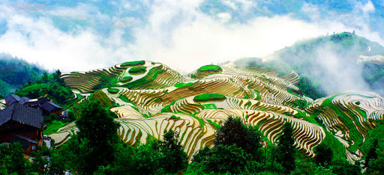
Rice Terraces in China
© Brain Wrinkles

Slide 13
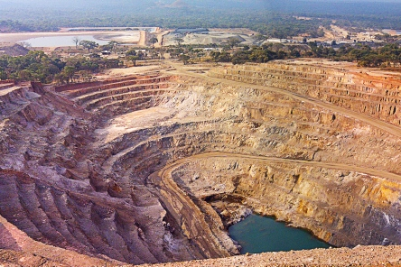
Kipoi Copper Mine in India
© Brain Wrinkles

Slide 14
SE Asia
China | India | Japan | S Korea | N Korea
Coal | Rice | Rice | Rice | Rice
Oil | Cotton | Fish | Barley | Corn
Natural gas | Copper |  | Wheat | Potatoes
Rice | Iron ore |  | Graphite | Zinc
Aluminum | Bauxite |  | Potatoes | Iron ore
Soybeans | Sugarcane |  | Soybeans | Coal
© Brain Wrinkles

Slide 15
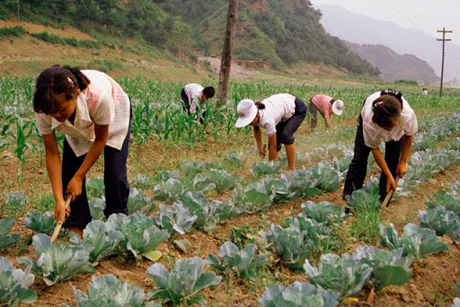
Cultivating Soybeans in South Korea
© Brain Wrinkles

Slide 16
Capital
Goods
© Brain Wrinkles

Slide 17
Capital Goods
Capital goods are the man-made materials that are needed to produce goods and services.
Some examples of capital goods include factories, machinery, technology, buildings, tools, etc.
The more a country invests in its capital goods, the stronger its economy and higher the GDP.
© Brain Wrinkles

Slide 18
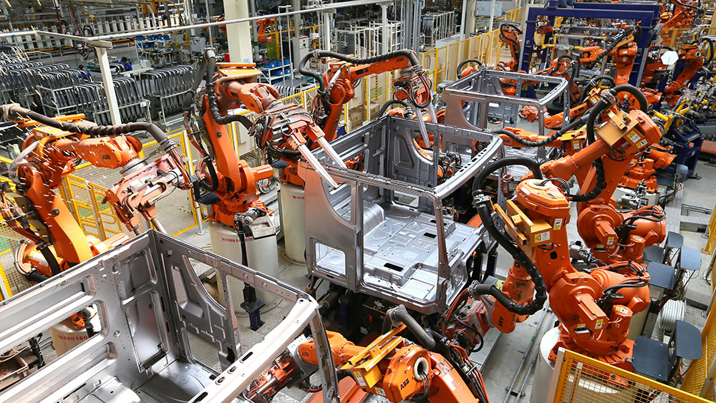
© Brain Wrinkles

Slide 19
Capital Goods
Investment in better machines, updated factories, and new technology leads to more goods and services being produced.
This boosts a country’s exports and its gross domestic product.
Investment in capital goods typically leads to an increase in GDP per capita.
© Brain Wrinkles

Slide 20
SE Asia
Governments of Japan, China, India, and South Korea have encouraged capital investments in order to strengthen their economies.
The countries have invested heavily in capital goods of new factories, machinery, and equipment, which has led to high levels of manufacturing and industry.
Their factories can produce a wide variety of valuable products, which has led to higher GDPs and stronger economies.
© Brain Wrinkles

Slide 21
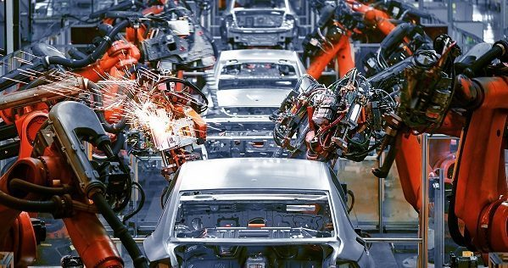
AI-Driven Factory in South Korea
© Brain Wrinkles

Slide 22
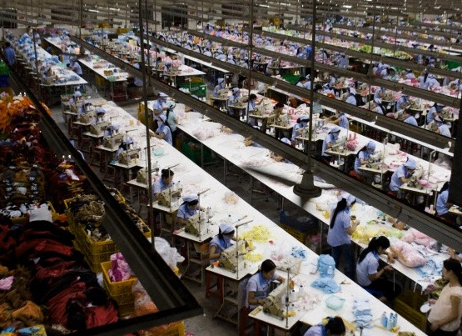
Toy Factory in China
© Brain Wrinkles

Slide 23
N Korea
North Korea, on the other hand, has only made small investments in capital goods over the past several decades.
Its outdated technology and inefficient factories have caused North Korea’s economy to suffer and fall behind on the world market.
© Brain Wrinkles

Slide 24
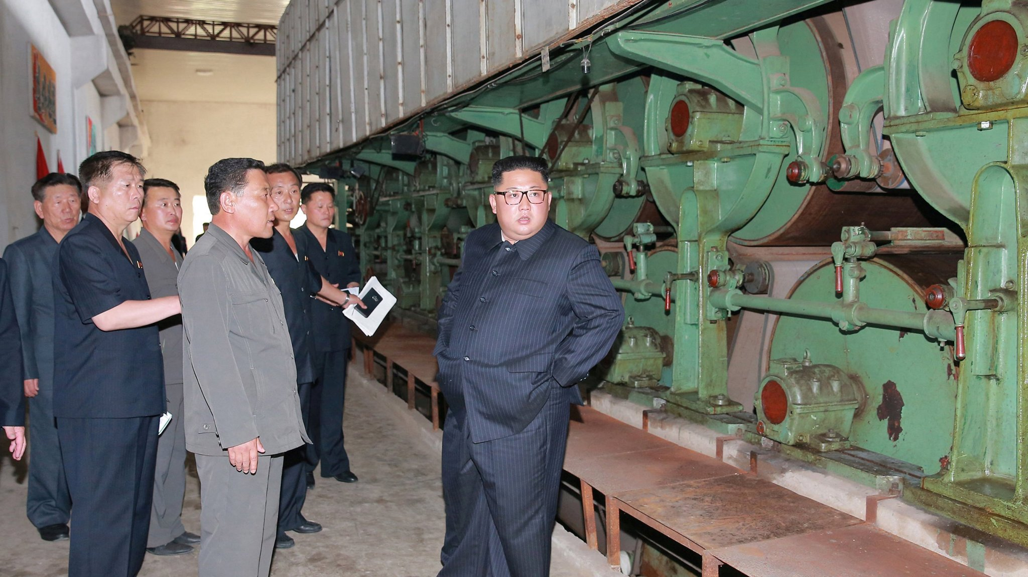
Supreme Leader Kim Jong Un oversees an industrial site in North Korea.
© Brain Wrinkles

Slide 25
Human
Capital
© Brain Wrinkles

Slide 26
Human Capital
Some of a country’s most important resources are its people.
Countries need skilled workers to fill jobs within the economy.
It takes different kinds of human capital to make different kinds of goods and services.
For example, doctors, teachers, and factory workers all have a different set of skills and they each help to produce different goods or services.
© Brain Wrinkles

Slide 27
© Brain Wrinkles

Slide 28
Human Capital
Investments in human capital, such as education and professional training programs, are a great way for a country to improve its GDP.
In order to have long-lasting economic growth, a country must have a smart, highly-skilled workforce.
Education also improves a country’s standard of living.
© Brain Wrinkles

Slide 29
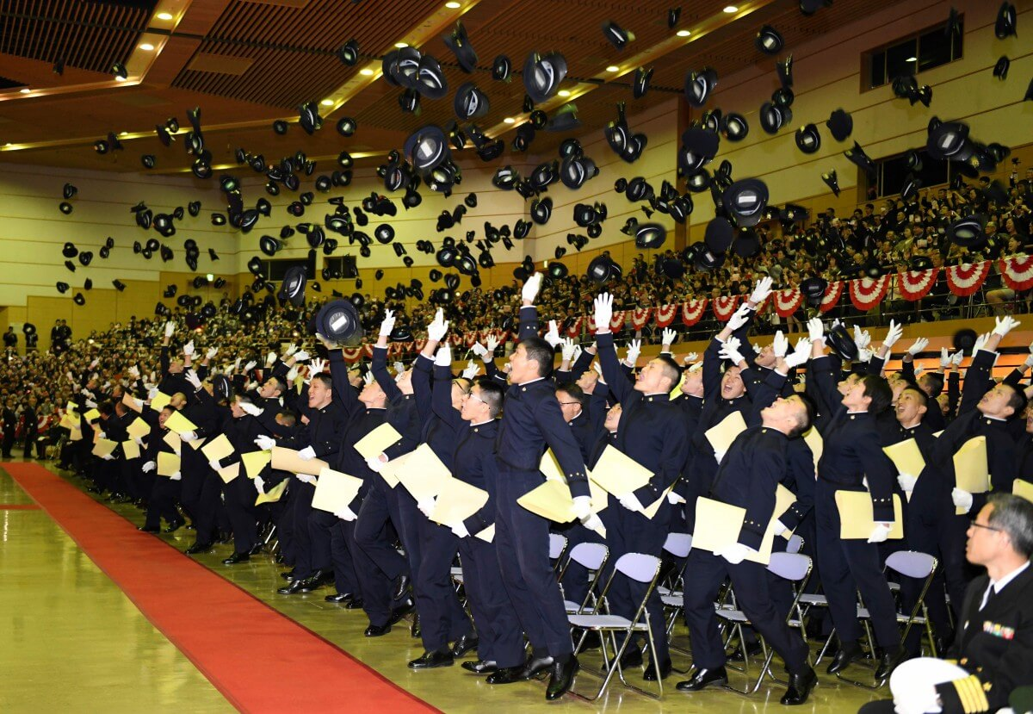
© Brain Wrinkles

Slide 30
SE Asia
SE Asian countries generally invest less of their budgets in K-12 education than other developed countries.
The world average is 6% and Japan invests 3.2%
Enrollment numbers in secondary schools have fallen across the region.
In response, many SE Asian countries have ramped up their investment in colleges and universities to keep up economically.
© Brain Wrinkles

Slide 31
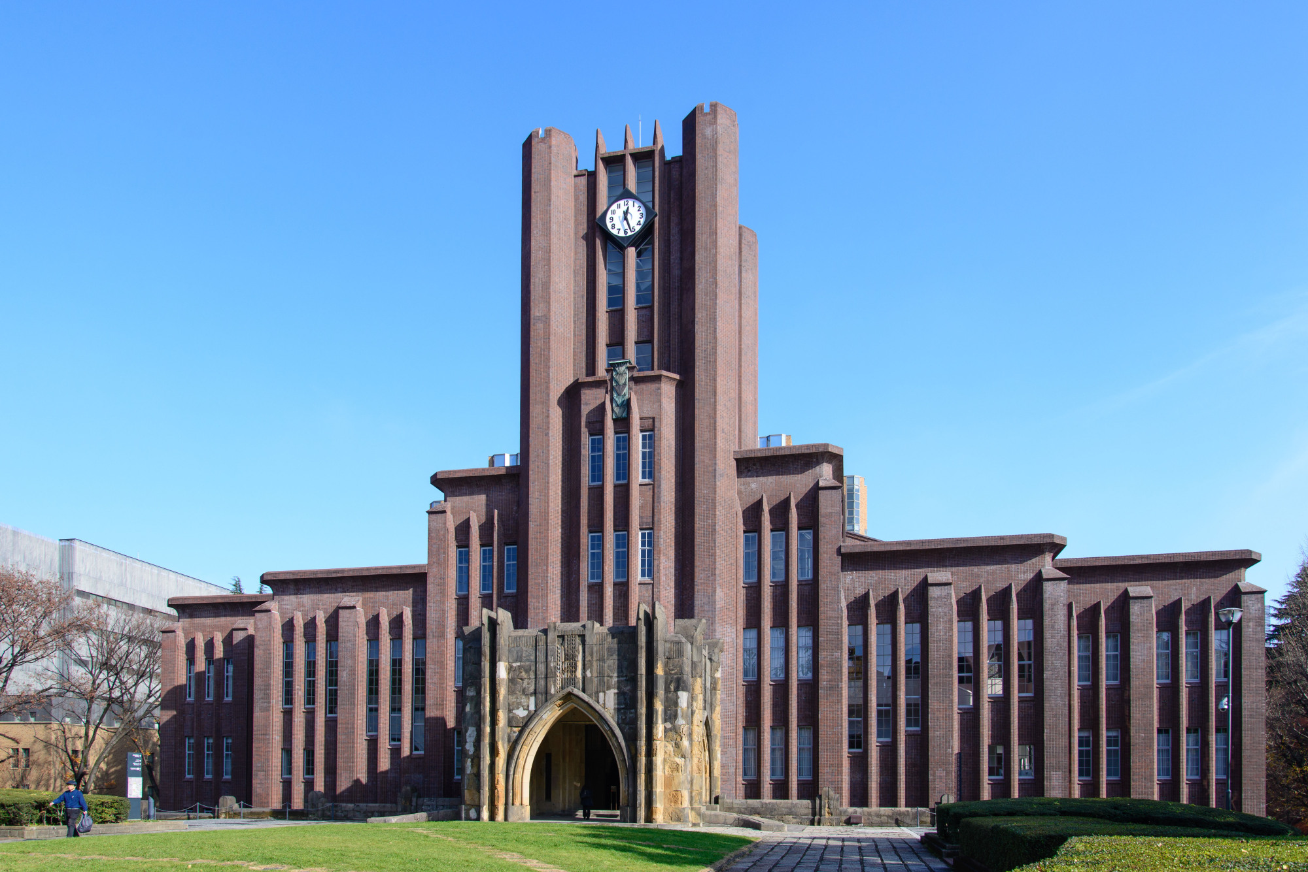
Tokyo University in Japan
© Brain Wrinkles

Slide 32
SE Asia
Even though investments in education are lower, the governments of India, Japan, China, and South Korea invest aggressively in programs to train their people for specific jobs and industries.
These investments in job training have made their economies grow.
Their workers are trained, skilled, and can communicate well.
© Brain Wrinkles

Slide 33
N Korea
North Korea invests heavily in human capital under the area of education.
Education in North Korea is universal and funded by the government.
The self-reported national literacy rate for citizens 15 and older is (approximately) 100%.
Despite North Korea’s high education investment, the country’s economy still struggles to grow under the strict control of the Communist government.
© Brain Wrinkles

Slide 34
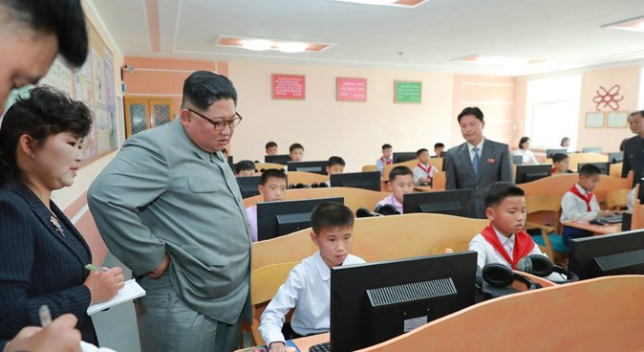
Leader Kim Jong Un overlooks middle school students in North Korea.
© Brain Wrinkles

Slide 35
Literacy
A country’s literacy rate is the percentage of adults who can read and write.
Countries with high literacy rates enjoy a high standard of living (the level of wealth and material comfort available).
Educated and skilled workers are an important factor in a country’s economic growth.
© Brain Wrinkles

Slide 36
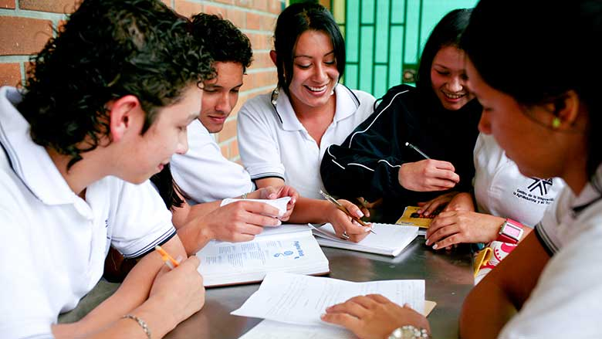
© Brain Wrinkles

Slide 37
Literacy
If you can read, you can learn and improve your work skills to get a better job that pays a higher salary.
With a better salary, you can improve your standard of living.
A country that improves the literacy rate among its citizens will also improve the standard of living and economy.
© Brain Wrinkles

Slide 38
Literacy Rate
SE Asia’s literacy rates are generally higher than the worldwide average 86.3% (except for India).
Country | Literacy Rate
China | 96.4%
India | 72.1%
Japan | 99.%
South Korea | 98%
North Korea | 100%*
*self-reported
© Brain Wrinkles

Slide 39
Entrepreneurship
© Brain Wrinkles

Slide 40
Entrepreneur
An entrepreneur is someone who takes risks to start a new business.
Entrepreneurs produce fresh ideas for goods or services and then they use natural resources, capital goods, and human capital to bring those ideas to life.
They help the economy grow by opening new businesses and developing new products, which creates more jobs.
© Brain Wrinkles

Slide 41
Nguyen Thi Phuong Thao (from Vietnam) is Southeast Asia’s only self-made billionaire. Thao launched VietJet Air in 2011 and it now boasts 34 domestic and 16 international routes. Thao recently ranked 44th on Forbes’ list of the World’s 100 Most Powerful Women.
© Brain Wrinkles

Slide 42
Risks
It is risky and expensive to be an entrepreneur because they often invest their own money (or borrow it) to start their business.
There is no guarantee of success, and if the business fails, they could lose money.
Some countries encourage entrepreneurship by trying to reduce the risk and expense.
© Brain Wrinkles

Slide 43
Dave Cho (from South Korea) is the CEO of Classting, the biggest Edtech service for schools. Previously he was an elementary school teacher. Cho has over 10 years of experience combining education with technology and he founded Classting to bridge the gap between Education and Technologies. Cho is one of the top Korean entrepreneurs in the EdTech space.
© Brain Wrinkles

Slide 44
Entrepreneurship
If a country’s government imposes a lot of regulations on businesses, it can be really hard on an entrepreneur.
Having an environment that promotes entrepreneurship is a great advantage to a country.
© Brain Wrinkles

Slide 45
In 2010, Vivy Yusuf (from Malaysia) launched Fashion Valet, a fashion e-commerce site that brings high-end designers to consumers. Yusuf’s enterprise has grown to 500 brands and hundreds of staff across Kuala Lumpur, Singapore and Jakarta. Among her brands is dUck, which offers affordable and trendy hijabs to Muslim women looking for modern day designs.
© Brain Wrinkles

Slide 46
SE Asia
South Korea’s government has done an excellent job in supporting and training entrepreneurs.
Entrepreneurship has been growing in Japan in recent years.
Unfortunately, tough government regulations, cultural biases, and high taxes make starting a business challenging in India and China.
Entrepreneurship is against the law in North Korea as the government makes all economic decisions.
© Brain Wrinkles

Slide 47
Christine Chang and Sarah Lee (from South Korea) are the Co-Founders of Glow Recipe. They are considered pioneers when it comes to Korean skincare and their brand became famous after appearing on ABC’s Shark Tank in 2015. Glow Recipe is now one of the leaders in the K-Beauty industry.
© Brain Wrinkles

Slide 48
Entrepreneurship
The worldwide average for starting a new business takes 21 days and the overall business freedom is 65%.
 | China | India | Japan | S Korea | N Korea
Starting a new business takes… | 29 days | 26 days | 11 days | 4 days | N/A
Overall Business Freedom | 54% | 53% | 82% | 91% | 5%
© Brain Wrinkles

